Slide 1
Midterm Debrief
CS 162: Natural Language Processing
Nanyun (Violet) Peng
Course website: https://vnpeng.net/cs162_win24.html
syllabus,
announcements,
slides,
homeworks
1

Slide 2
Announcement
Project midterm report due tonight at 11:59pm!
You should be keeping the momentum to work on the course project!
From week 7/8 on, we will start to have weekly project submission windows for you to check your model performances.

Slide 3
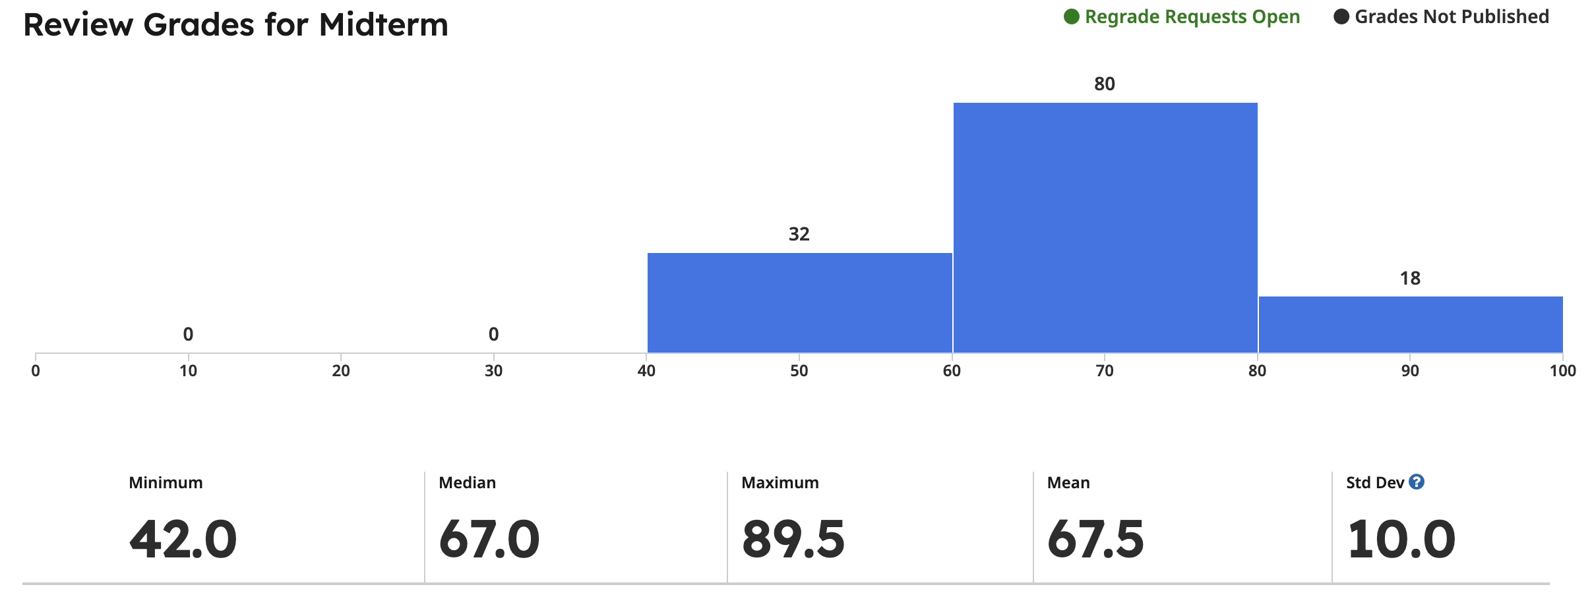
Preliminary midterm score distribution

Slide 4
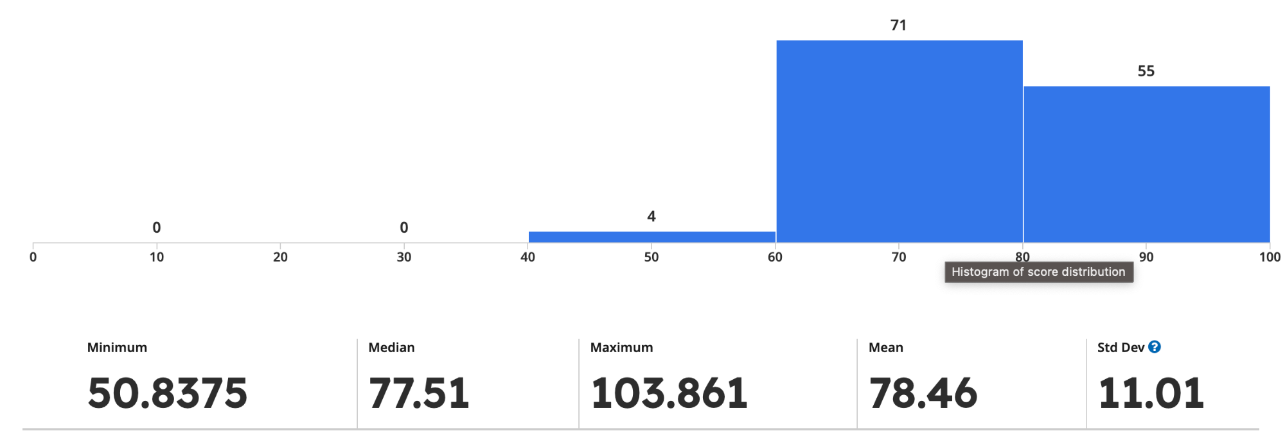
Adjusted midterm score distribution

Slide 5
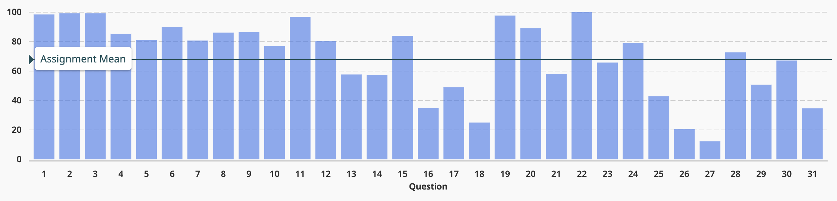
Breakdown by questions
Transformer
N-gram LM

Slide 6
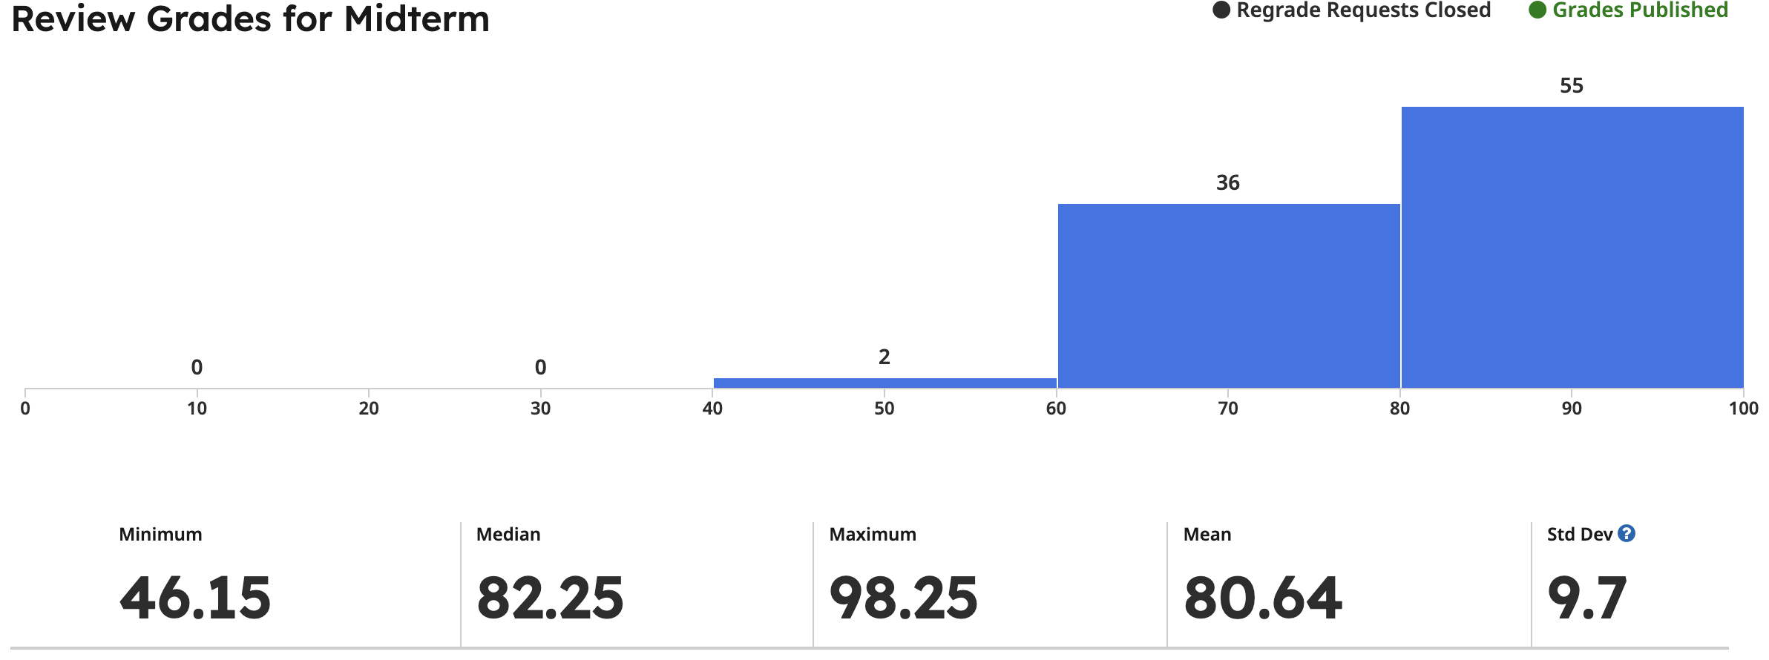
Last year’s distribution
Notes:
I will give everyone 5 points on midterm.

Slide 7
Proposal
Change the transformer question as a bonus question.
Everyone has the opportunity to get 5% credit bump for submitting the course survey.
Two grading schemas, will auto assign the highest:
midterm 15%, final 30%
midterm 20%, final 25%

Slide 8
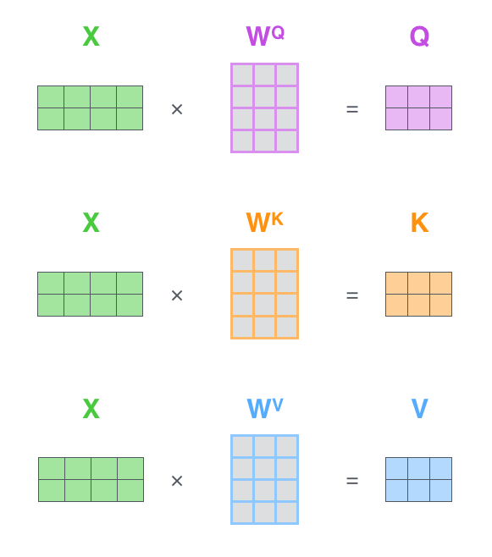


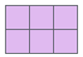
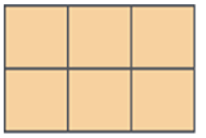

Transformer Self-Attention Recap
thinking
machine
thinking
machine
massive
thunderstorm
in
California
thinking
machine
massive
thunderstorm
in
California

Slide 9
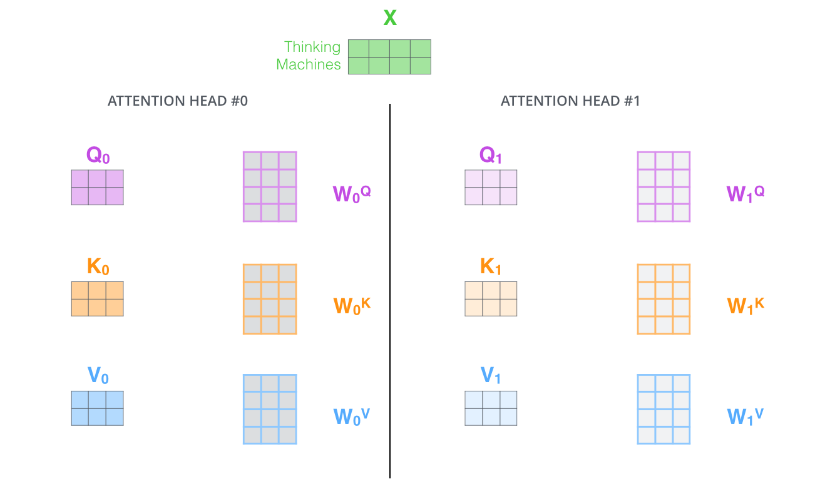
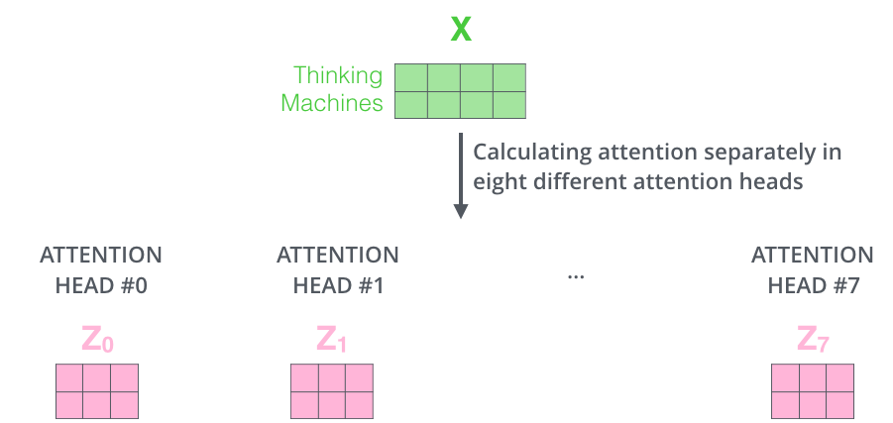
Transformer Multihead Attention Recap

Slide 10
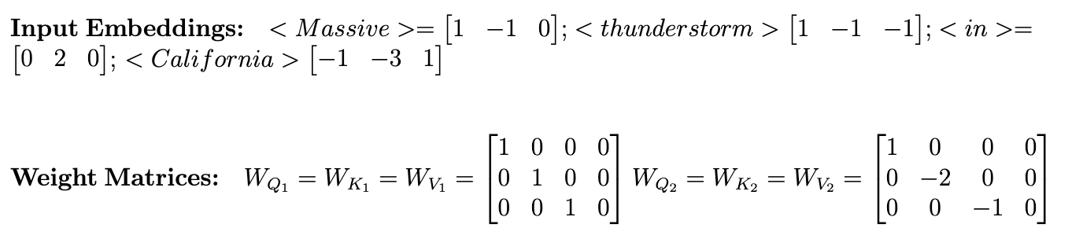

Slide 11
Pretraining Recap

Slide 12
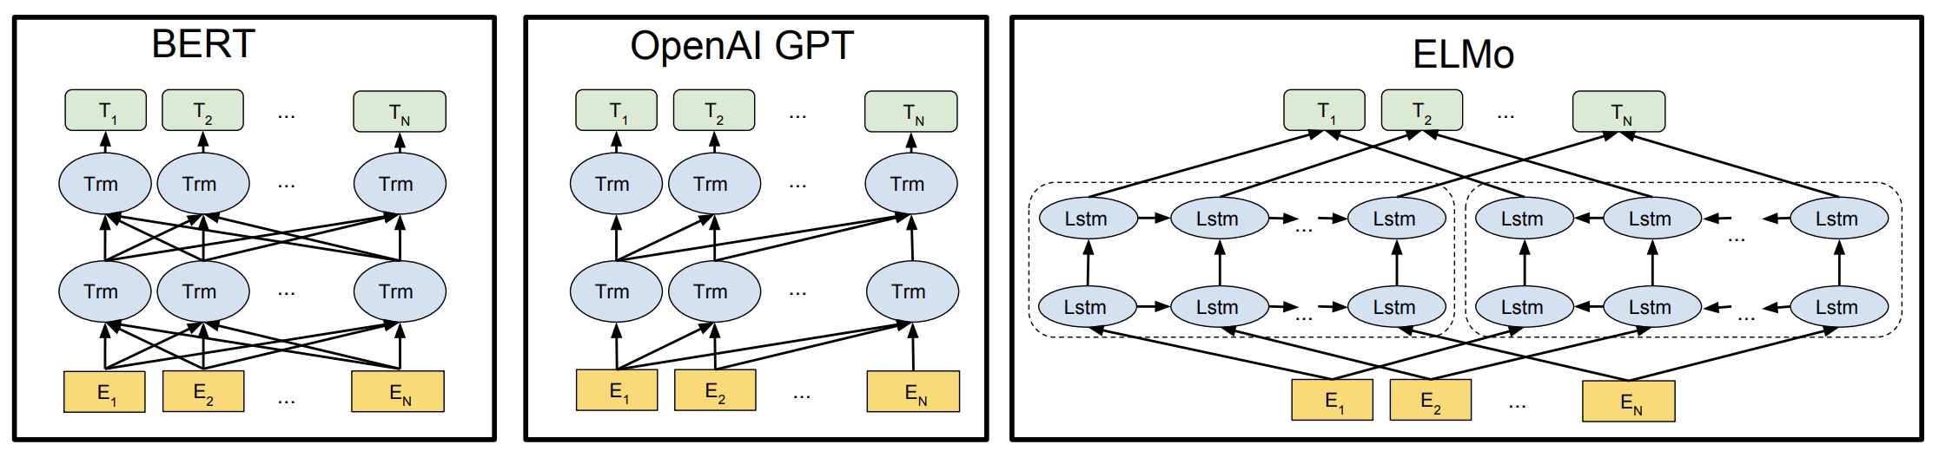
Pre-training Model Architectures
Bidirectional Unidirectional Independently bidirectional
Jacob Devlin, et al. BERT: Pre-training of Deep Bidirectional Transformers for Language Understanding. NAACL 2018.

Slide 13
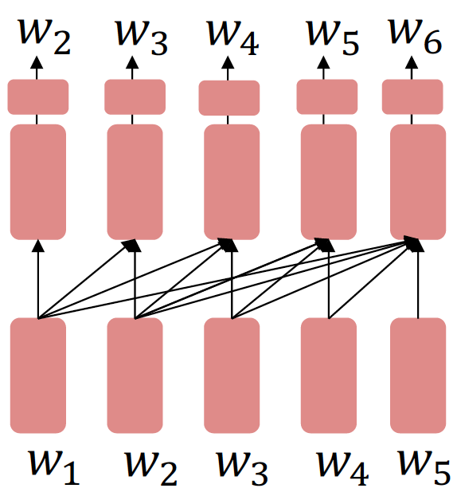
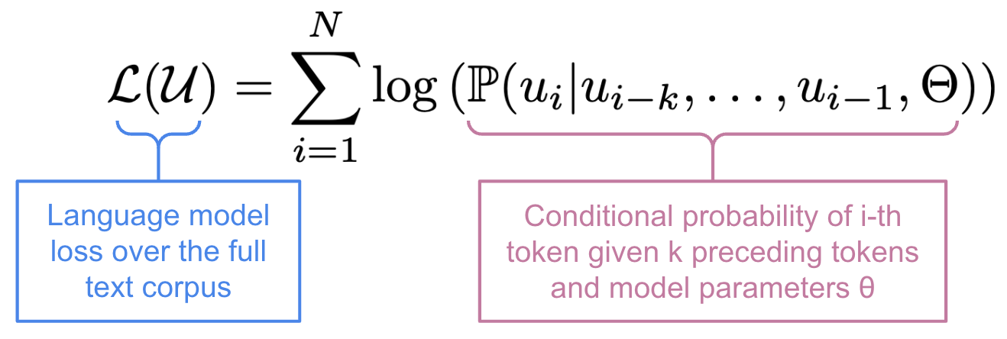
Unidirectional Pre-training
Decoder-only and cannot condition on future words
Improving Language Understanding by
Generative Pre-Training (GPT), OpenAI, 2018

Slide 14
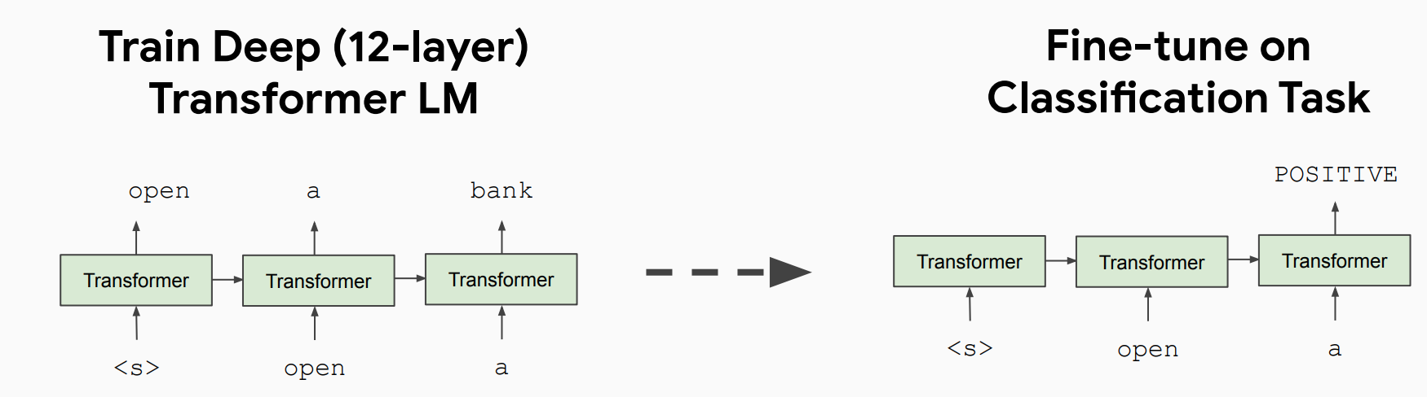
GPT Pre-training and Fine-tuning
After pre-training, finetune by training a classifier on the hidden state of the last word
Paper title: Language Models are Few-Shot Learners, A.K.A. GPT-3. Neurips 2020, best paper award.

Slide 15
GPT Technical Details
GPT in 2018 was a big success in pre-training a decoder!
Transformer decoder with 12 layers, 117M parameters
768-dimensional hidden states, 3072-dimensional feed-forward hidden layers
Byte-pair encoding with 40,000 tokens
Trained on BooksCorpus: over 7000 unique books.
Contains long spans of contiguous text, for learning long-distance dependencies.

Slide 16
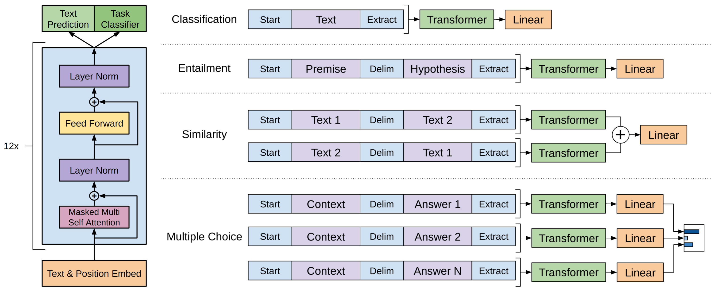
Fine-tuning GPT for Downstream Tasks

Slide 17
GPT for Natural Language Inference
How to format inputs to the decoder for finetuning tasks?
Natural Language Inference: Label pairs of sentences as entailing/contradictory/neutral
[START] The man is in the doorway [DELIM] The person is near the door [EXTRACT]
The linear classifier is applied to the representation of the [EXTRACT] token

Slide 18
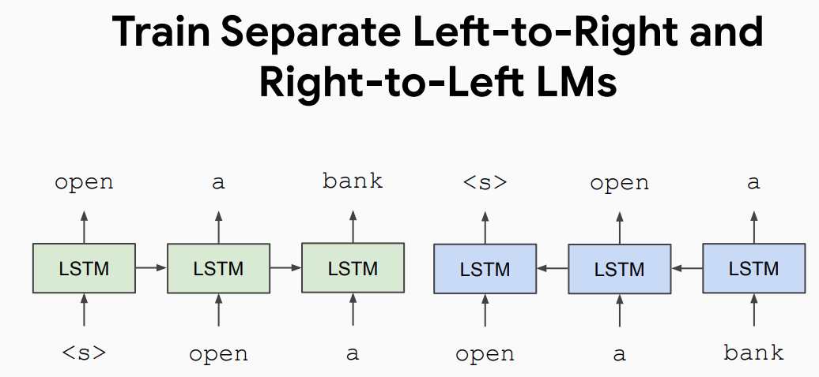
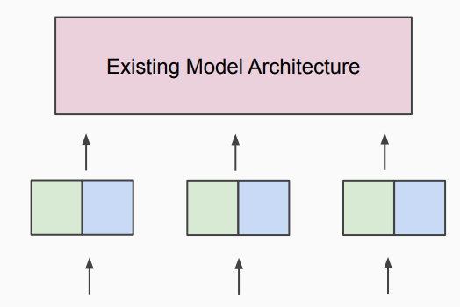

Independently Bidirectional Pre-training
Apply as “Pre-trained Contextualized Embeddings”
Paper title: Deep Contextual Word Embeddings, AI2 & University of Washington, NAACL 2018, best paper award.
ELMo (Embeddings from Language Models)

Slide 19
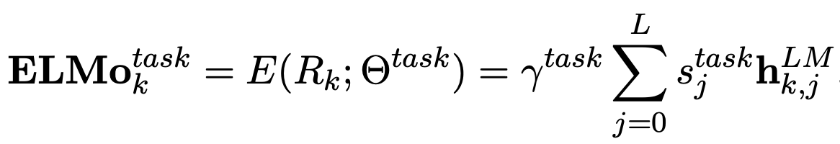
ELMo Technical Details
The final representation of each word is a task-specific combination of the representations in the intermediate layers (forward + backward) and token layer

Slide 20
Potential Problems of ELMo and GPT series
Language models only use left context or right context, but language understanding is bidirectional.
E.g., I put ___ down on the table with the caviar.
ELMo: shallow/hacky bidirectional encoding.
GPT: purely unidirectional.

Slide 21
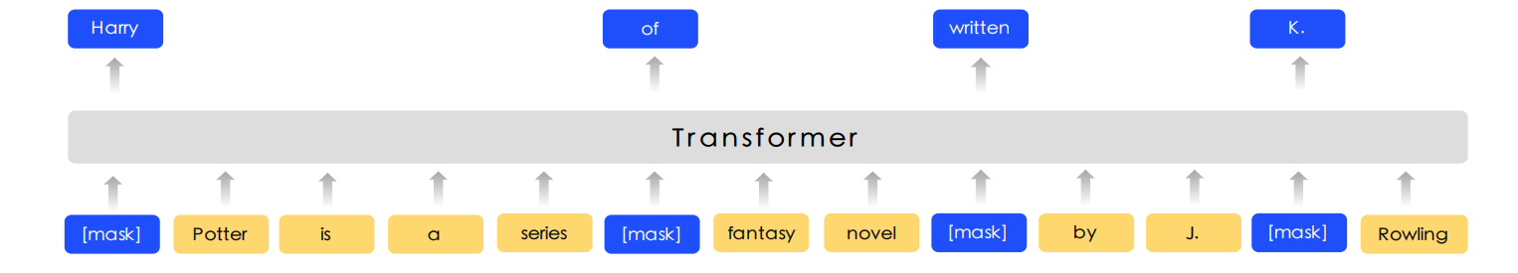
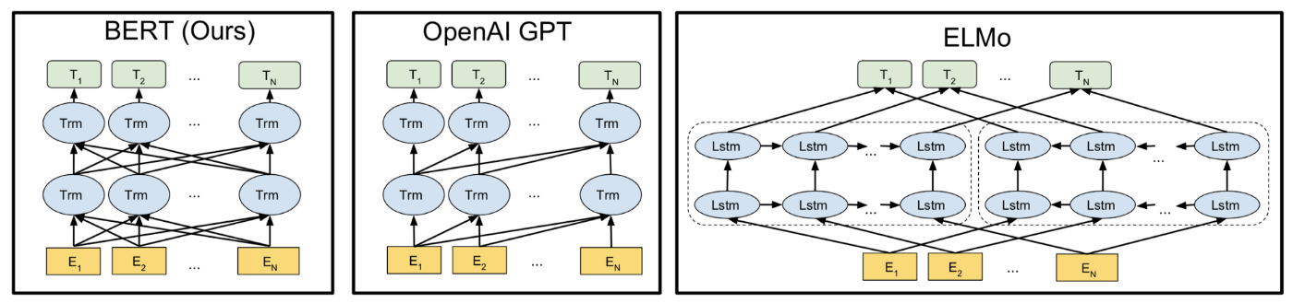

Bidirectional Pre-training
Encoder-only and condition on bidirectional words
BERT: Bidirectional Encoder Representations from Transformers
Paper title: BERT: Pre-training of Deep Bidirectional Transformers for Language Understanding, Google Research, NAACL 2019, best paper award.

Slide 22
Masked Language Models
Mask out k% of the input words, and then predict the masked words
Usually use k = 15% (Only add loss terms from words that are masked out)
Too little masking: Too expensive to train
Too much masking: Not enough context
Among k = 15% (To mitigate a mismatch between pre-training and fine-tuning)
80% of the time: replace input word with special [MASK] token
10% of the time: replace input word with a random token
10% of the time: leave input word unchanged (but still predict it!)
store gallon
The man went to the [MASK] to buy a [MASK] of milk

Slide 23
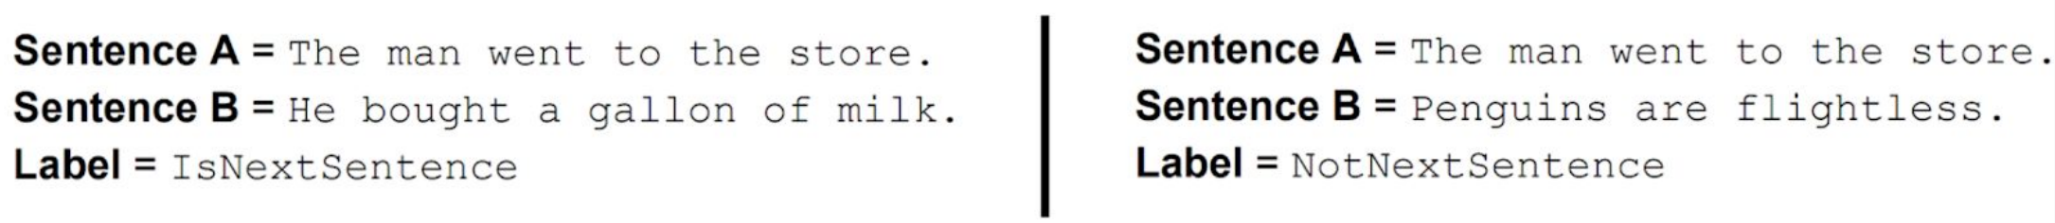
Next Sentence Prediction
To learn relationships between sentences, predict whether Sentence B is actual sentence that proceeds Sentence A, or a random sentence.

Slide 24
BERT Input Representation
The input to BERT was two separate contiguous segments of text:
Token embeddings: 30k token vocabulary, special tokens [CLS] and [SEP]
Segment embeddings: to distinguish the two input segments
Position embeddings: to explicitly encode the word order

Slide 25
BERT Technical Details
Data: Wikipedia (2.5B words) + BookCorpus (800M words)
Batch Size: 131,072 words (1024 sequences * 128 length or 256 sequences * 512 length)
Training Time: 1M steps (~40 epochs)
Optimizer: AdamW, 1e-4 learning rate, linear decay
BERT-Base: 12-layer, 768-hidden, 12-head
BERT-Large: 24-layer, 1024-hidden, 16-head
Trained on 4x4 or 8x8 TPU slice for 4 days

Slide 26
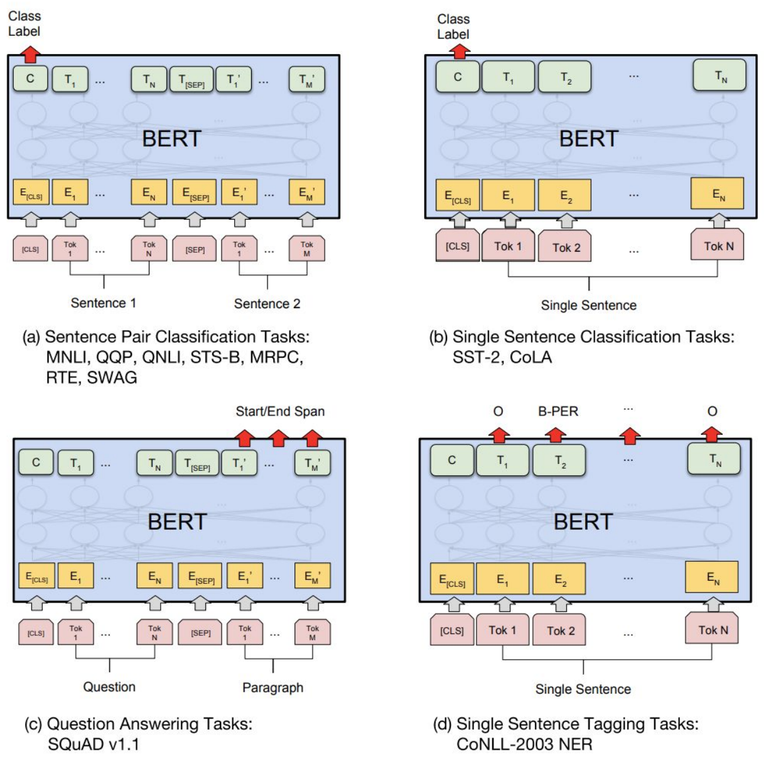
BERT Fine-tuning
Pre-training is expensive and impractical on a single GPU
Fine-tuning is practical and common on a single GPU

